Slide 1
Welcome to The Fellowship 01.08.12

Slide 2
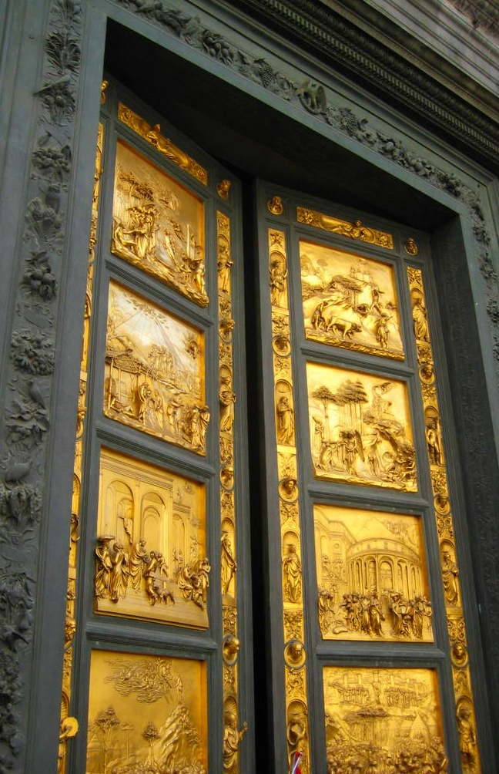
The Testimony
Giving Praise
to
Our God

Slide 3
Testimonies from
The Old Testament
Testimonies
Two Types:
Beginning our Salvation
Our walk with the Lord

Slide 4
Testimonies from
The Old Testament
Testimonies
Two Types:
Our walk with the Lord
January 8, 2012 – Look into Old Testament examples
January 15, 2012 – Look into New Testament examples
The beginning of our Salvation
January 22, 2012

Slide 5
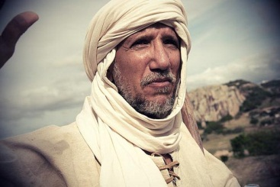
Testimonies from
The Old Testament
Eliezer of Damascus
Genesis 24:23-48

Slide 6
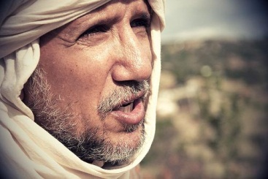
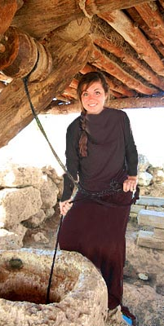
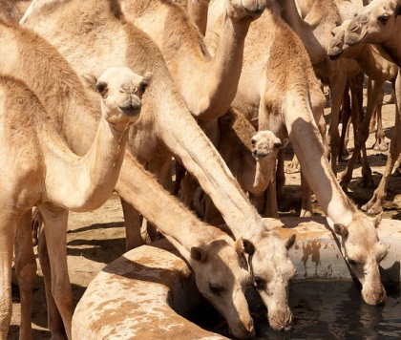
Testimonies from
The Old Testament
Eliezer of Damascus
Genesis 24:23-48

Slide 7
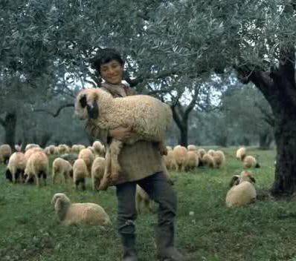
Testimonies from
The Old Testament
David of Bethlehem

Slide 8
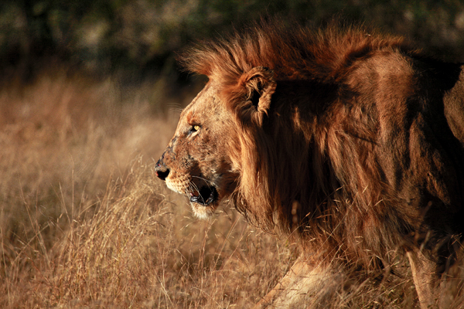
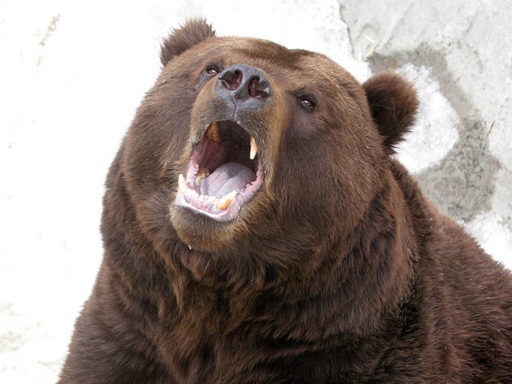
Testimonies from
The Old Testament
David of Bethlehem
1 Samuel 17:34-37
But David said to Saul, “Your servant used to keep his father’s sheep, and when a lion or a bear came and took a lamb out of the flock, I went out after it and struck it, and delivered the lamb from its mouth; and when it arose against me, I caught it by its beard, and struck and killed it. Your servant has killed both lion and bear; and this uncircumcised Philistine will be like one of them, seeing he has defied the armies of the living God.”
Moreover David said, “The LORD, who delivered me from the paw of the lion and from the paw of the bear, He will deliver me from the hand of this Philistine.”

Slide 9
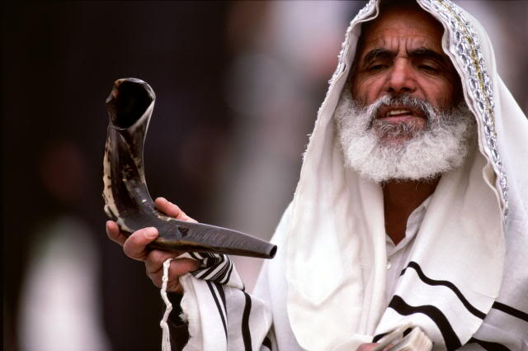
Testimonies from
The Old Testament
Isaiah of Judah
Isaiah 6

Slide 10
Testimonies from
The Old Testament
What was similar in
all the testimonies?
The Lord given proper place
The person trusting the Lord
There was a main thought of what the Lord did in the situation

Slide 11
Testimonies from
The Old Testament
Eliezer of Damascus
Genesis 24:48
And I bowed my head and worshiped the LORD,
and blessed the LORD God of my master Abraham,
who had led me in the way of truth

Slide 12
Testimonies from
The Old Testament
Eliezer of Damascus
Genesis 24:48
Guidance

Slide 13
Testimonies from
The Old Testament
David of Bethlehem
1 Samuel 17:37
The LORD, who delivered me …
He will deliver me …

Slide 14
Testimonies from
The Old Testament
David of Bethlehem
1 Samuel 17:37
Protection - Deliverance

Slide 15
Testimonies from
The Old Testament
Isaiah of Judah
Isaiah 6
The Lord is Holy
The Lord provides cleansing
The Lord Commissions
the voice of the Lord…Whom shall I send, And who will go for Us?”
Here Am I Send Me

Slide 16
Testimonies from
The Old Testament
Isaiah of Judah
Isaiah 6
Sending to Serve

Slide 17
Testimonies from
The Old Testament
Topic of Testimony
Guidance
Deliverance – Protection
Sending to Serve
What are other topics of God’s mercy, grace and provision?

Slide 18
Testimonies from
The Old Testament
Giving Testimonies Today
Some Elements to include
What God has done?
What was the setting?
How were you involved?
What were the results?
Emphasis on God

Slide 19
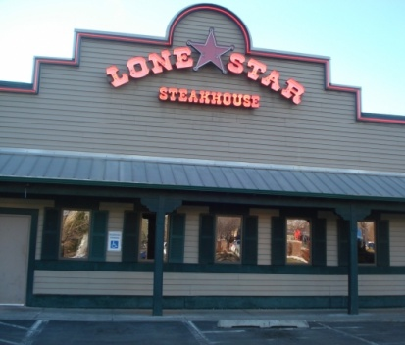
Testimonies from
This Week
The Lord led me to one who did not walk with Him and began to open the heart of a young lady to Himself.
Went to lunch with a friend
Prayed as went in for server
Engaged with going to pray
Talked about school
Found a specific request

Slide 20
Testimonies from
This Week
My friend left a great tip to help her to remember the encounter
I have been praying for this one each day for the class in science she is taking during January.
Asking the Lord to help her with this subject that is difficult for her
She does not seem to have a relationship with the Lord so I am praying she will come to know the one who knows all about science.

Slide 21
Testimonies from
Today
Your turn
Think of a time God worked
What God has done?
What was the setting?
How were you involved?
What were the results?
Remember: Emphasis on God

Slide 22
Welcome to The Fellowship 01.08.12

